Slide 1
Equilibrium
Success Criteria
I can state the rules for equilibrium.
I can calculate complex torque and equilibrium questions.

Slide 2
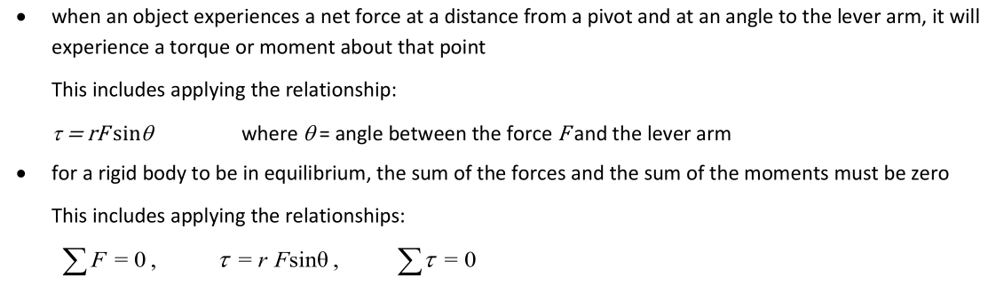
Torque
Link to Syllabus

Slide 3
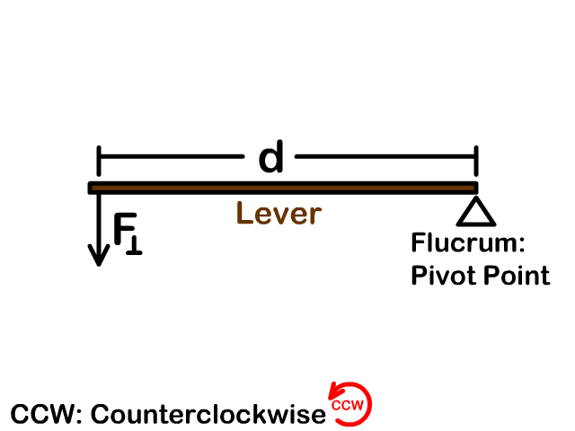
Rotational Equilibrium
Content Development
Torque, like force, has a direction. As the torque is a turning effect, the torque is either clockwise (CW) or anticlockwise (ACW).
Imagine the lever is the hand of a clock: if it is moving in the correct direction, it is clockwise.
W
W
ACW
CW
W
W

Slide 4


Rotational Equilibrium
Content Development
If the clockwise torque equals to anticlockwise torque, the lever will not rotate.
This is known as rotational equilibrium.
$$τcw=τacw$$
W
W
You may have multiple torques acting on each side of the lever. If so, we have to identify all of the torques, classify them, and add them.
$$Στcw=Στacw$$
W₁
W₂
W₃

Slide 5

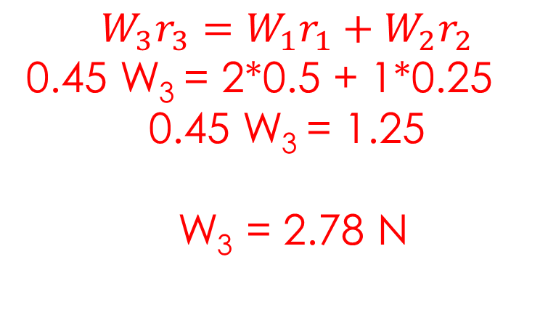
Rotational Equilibrium
Practice Question
Identify clockwise and anticlockwise torques.
  CW: W₃
  ACW: W₁ and W₂
State formula
Substitute and solve
r₃
W₁
W₂
r₂
W₃
r₁
W₁ = 2 N
W₂ = 1 N
r₁ = 0.50 m
r₂ = 0.25 m
r₃ = 0.45 m
The beam is uniform and the pivot is at the midpoint of the beam.
Calculate W₃ for the beam to be in rotational equilibrium
$$Στcw=Στacw$$
$$W_{3}r_{3}=W_{1}r_{1}+W_{2}r_{2}$$
0.45 W₃ = 2*0.5 + 1*0.25
0.45 W₃ = 1.25
W₃ = 2.78 N

Slide 6
Rotational Equilibrium
Draw a picture!
You do
Three people are sitting on a see-saw. Two people are on the left arm: one with a mass of 45.0 kg at a distance of 1.20m from the pivot, one with a mass of 60.0 kg at a distance of 0.80m from the pivot.
The third person has a mass of 75 kg. How far from the pivot must they sit for the see-saw to be in rotational equilibrium?
Notes:
ACW torque = 45 * 1.2 * 9.8 + 60 * 0.8 * 9.8 = 999.6 Nm
CW torque = 999.6 Nm = 75 * 9.8 * r
r = 1.36 m from the pivot

Slide 7
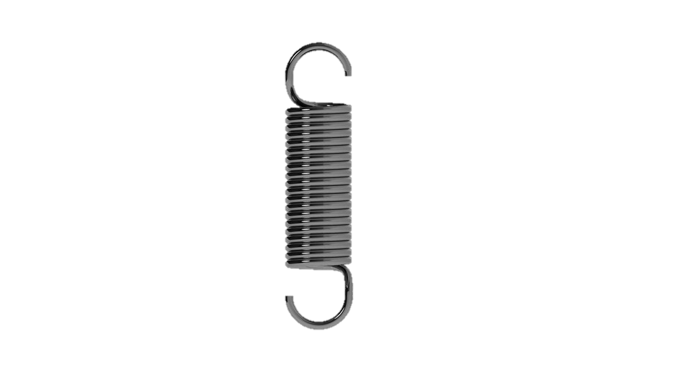
Rotational Equilibrium
You do
W₂ = 33 N
T = 10 N
r₃ = 3 m
W₁=12 N
r₁ = 3 m
Where would you place the 33 N weight so that the beam is in rotational equilibrium?
Notes:
ACW torque = 12 * 3 + 10 * 3 = 66 N
Need a clockwise torque to balance.
CW = 66 N = Fr = 33 * r
r = 2 m
Remember direction. Needs to be clockwise so weight is placed on the right.

Slide 8

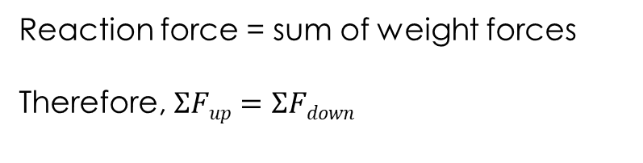

Translational Equilibrium
Content Development
In addition to rotational equilibrium, there is translational equilibrium.
Rotational equilibrium = the lever is not turning (rotating).
Translation equilibrium = the lever is not being pushed in any direction.
This occurs with the sum of forces acting on the lever are zero.
$$ΣFup=ΣFdown$$
$$ΣFleft=ΣFright$$
Reaction force
Reaction force = sum of weight forces
Therefore, $ΣFup=ΣFdown$
W
W

Slide 9



Static Equilibrium
Content Development
For an object to be in static equilibrium (not moving), it needs to have both rotational and translational equilibrium.
All three conditions must apply:
Be comfortable writing this. For all static equilibrium questions, you should write out all three statements clearly at the start of the question.
$$ΣFup=ΣFdown$$
$$ΣFleft=ΣFright$$
$$Στcw=Στacw$$

Slide 10
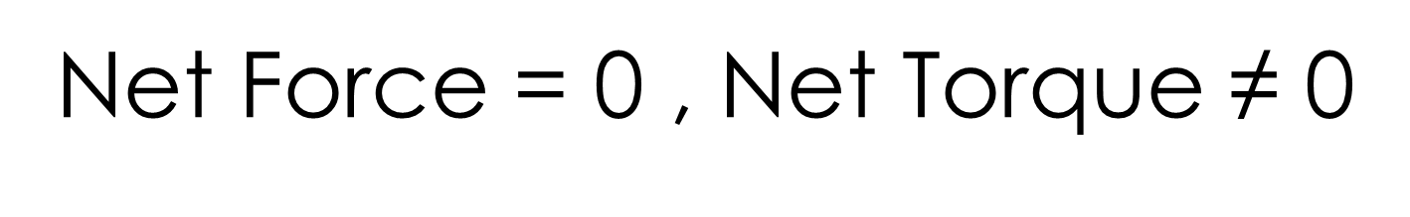
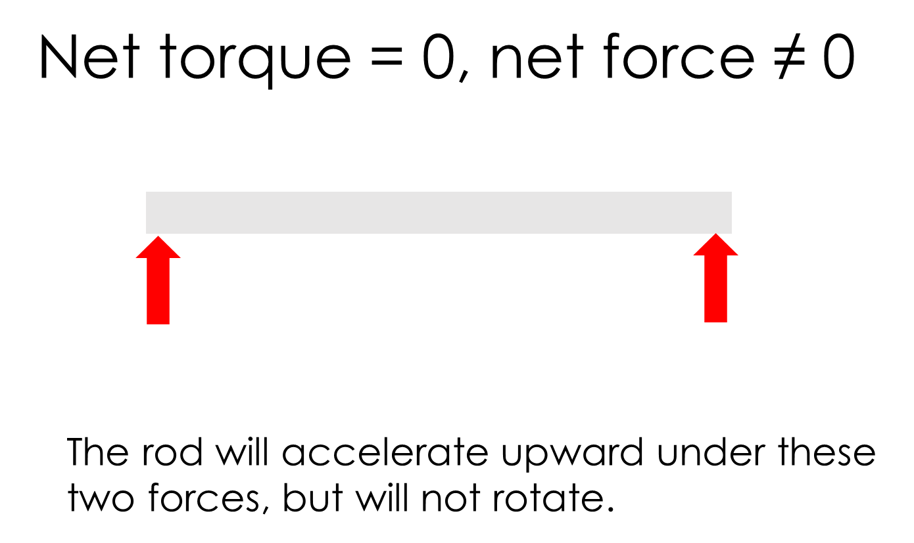
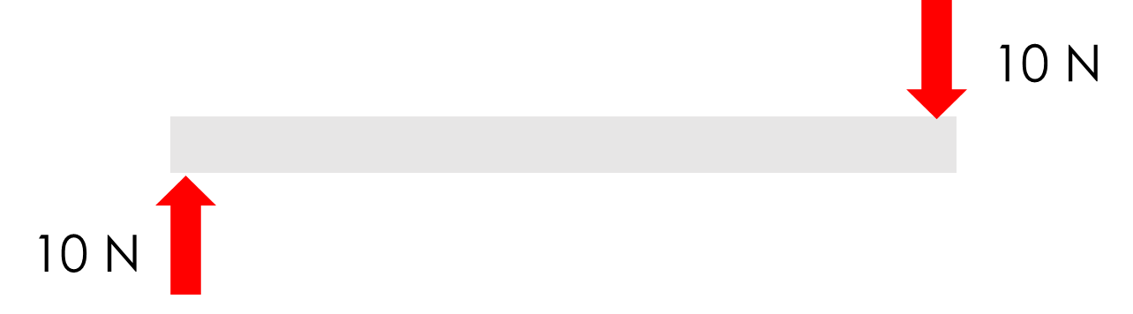
Static Equilibrium
Content Development
The net force = 0, since the forces are applied in opposite directions so it will not accelerate translationally.
However, together these forces will make the rod rotate in the clockwise direction.

Slide 11
Complex Torque Questions
Proof
For an object to be at equilibrium, it needs to be balanced at all points. We normally take that point at the pivot, but you can take another point if convenient.
Your Task
Show that the torque is balanced at all the named points.
2m
4m
15 N
1m
10 N
5 N
B
D
A
C

Slide 12
Complex Torque Questions
Content Development
There is a trick that you can use for solving complex torque questions:
  To be in rotational equilibrium, all points on a lever must have balanced torques
  Any force acting at chosen point will have a zero torque (as distance = zero)
This allows you to solve questions when they don’t seem like they have enough information.
Does not create a torque
Calculate torques around pivot
Creates a torque
Reaction force
Creates a torque
W
W

Slide 13
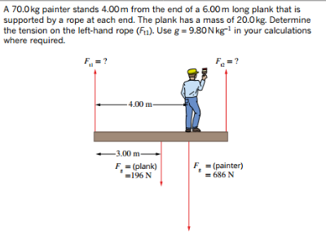
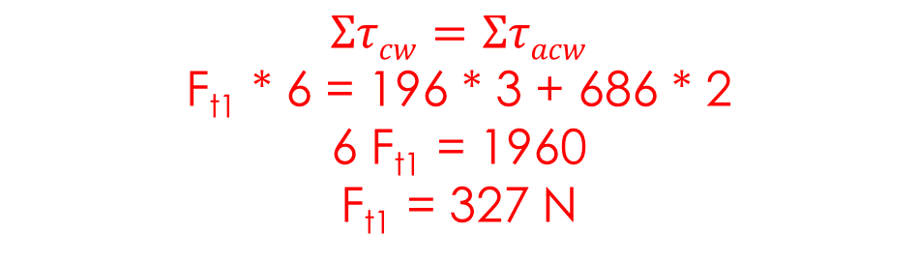



Static Equilibrium
Content Development
The plank is in static equilibrium therefore:
Take the torques at F_{t2}:
CW torques: F_{t1}
ACW torques: F_{g,plank} , F_{g,painter}
$$Στcw=Στacw$$
$$ΣFleft=ΣFright$$
$$ΣFup=ΣFdown$$
$$Στcw=Στacw$$
F_{t1} * 6 = 196 * 3 + 686 * 2
6 F_{t1} = 1960
F_{t1} = 327 N

Slide 14
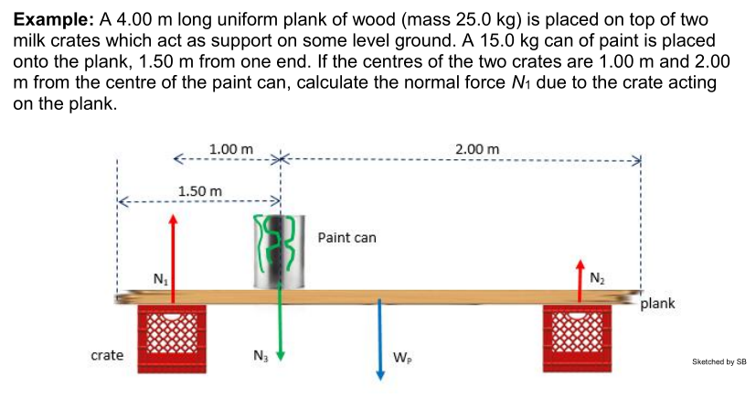
Static Equilibrium
You Do
1.50m
Notes:
Take torques around N2 to remove N2 from equation
N1 * r1 = N3 * r3 + Wp * r2
3 N1 = 15 * 9.8 * 2 + 25 * 9.8 * 1.5
N1 = 220.5 N

Slide 15
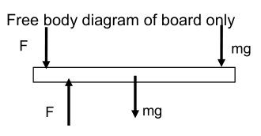
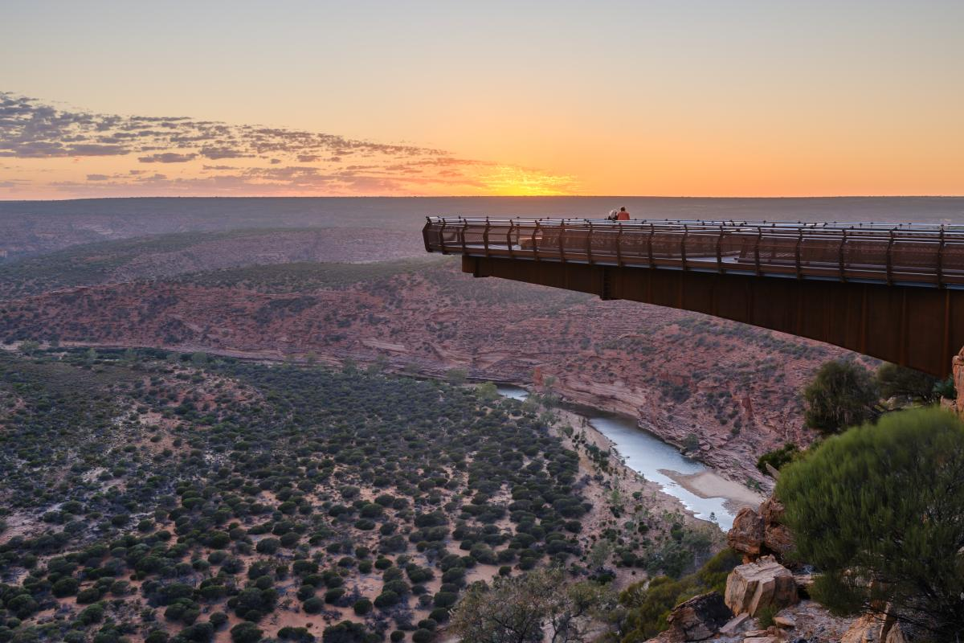
Static Equilibrium
Diving boards / Cantilevers
Cantilevers are levers that are supported only on one side. For the torques to be balanced, the support furthest from the weight must supply a downwards force. The other support supplies an upwards force.
To solve, calculate the torques from one of the supports. Remember: to be in equilibrium the torques must balance and the forces must balance.

Slide 16

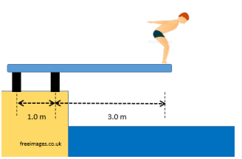
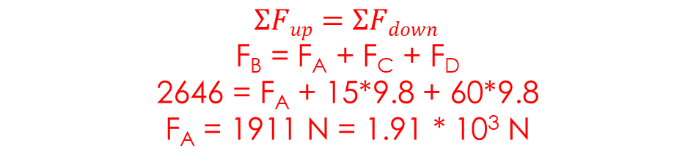

Static Equilibrium
Diving boards / Cantilevers
Cannot solve normally because there are two unknowns (F_{A} and F_{B})
Identify and label forces
  Down: F_{A}, F_{C}, F_{D}
  Up: F_{B}
Take torques around one of the supports. I chose the left support (F_{A})
  CW: F_{C} and F_{D}
  ACW: F_{B}
Now balance forces
F_{A}
F_{B}
F_{C}
F_{D}
$$Στcw=Στacw τ=Fr$$
F_{C}r_{c} + F_{D}r_{D} = F_{B}r_{B}
15*9.8*2 + 60*9.8*4 = F_{B}
F_{B} = 2646 N = 2.65 * 10³ N
$$ΣFup=ΣFdown$$
F_{B} = F_{A} + F_{C} + F_{D}
2646 = F_{A} + 15*9.8 + 60*9.8
F_{A} = 1911 N = 1.91 * 10³ N

Slide 17
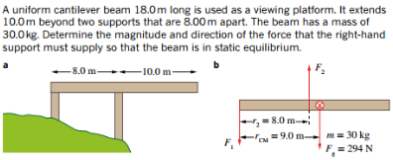
Static Equilibrium
You Do

Slide 18
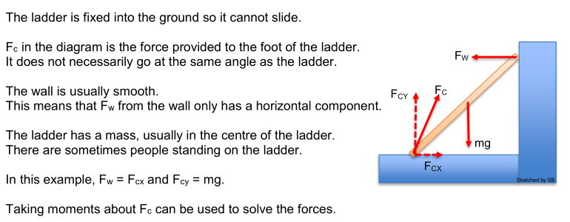
Static Equilibrium
Ladders

Slide 19

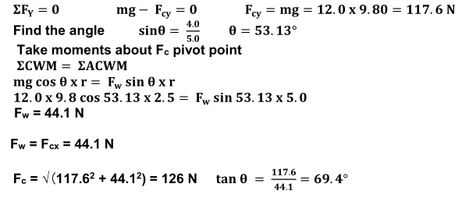
Static Equilibrium
Ladders

Slide 20
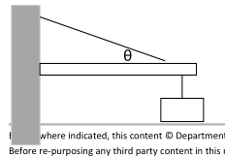
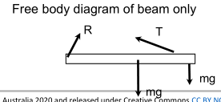
Static Equilibrium
Signs and Cranes
Signs and cranes add another layer of complexity as they are not typically at right angles. As such, you need to calculate force components and ensure that you are using the angles correctly.
Additionally, there is a reaction force at the wall or crane body. This reaction force is not very predictable (its direction and magnitude depend on the other forces) and must be calculated each time.

Slide 21
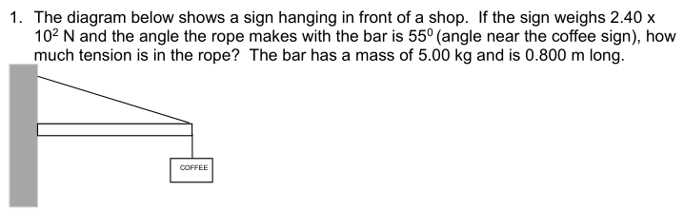

Static Equilibrium
Signs and Cranes
Identify and label forces
  T (acting left and up), R (right and ?), W_{b} (down), W_{s} (down)
Take torques around where the sign joins the wall
Now balance forces to solve for R
$$Στcw=Στacw τ=Fr sinθ$$
W_{b} r_{b} + W_{s} r_{s} = T r_{t} sinθ
5 * 9.8 * 0.4 + 240 * 0.8 = T * 0.8 * sin(55)
T = 3.23*10² N
Also solve for the reaction force the wall exerts on the bar.

Slide 22
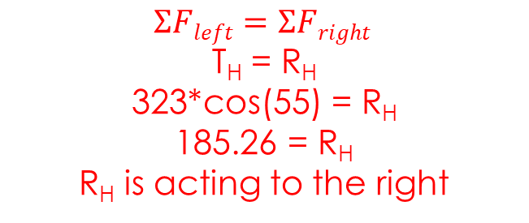
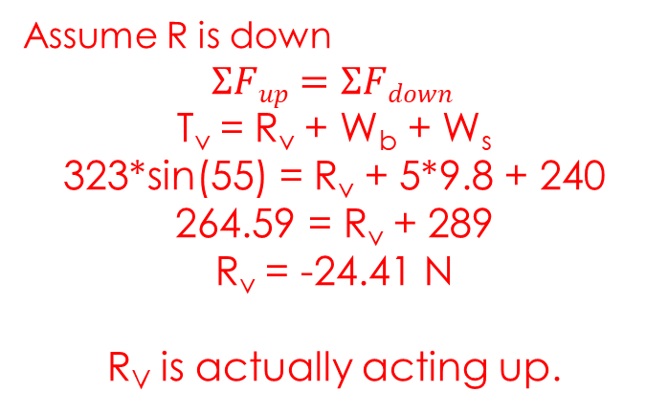
Static Equilibrium
Signs and Cranes
T = 3.23*10² N
Balance forces to solve for R
Assume R is down
$$ΣFup=ΣFdown$$
T_{v} = R_{v} + W_{b} + W_{s}
323*sin(55) = R_{v} + 5*9.8 + 240
264.59 = R_{v} + 289
R_{v} = -24.41 N
R_{V} is actually acting up.
$$ΣFleft=ΣFright$$
T_{H} = R_{H}
323*cos(55) = R_{H}
185.26 = R_{H}
R_{H} is acting to the right
Also solve for the reaction force the wall exerts on the bar.
R
R_{v}
R_{H}
Use trigonometry to solve for R:
R = sqrt(R_{V}² + R_{H}²) = 187 N
θ = tan⁻¹ (R_{V}/R_{H}) = 7.5º R is 187 N at 7.5º to the horizontal

Slide 23
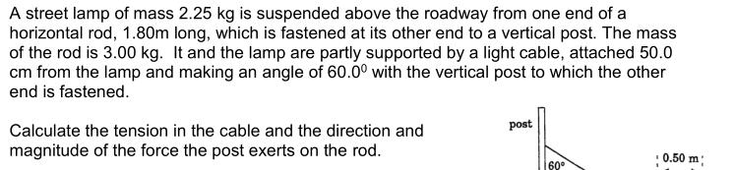
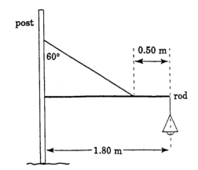
Static Equilibrium
You Do
Notes:
take moments about fastener
Tsin 30 x 1.3 = 2.25 x 9.8 x 1.8 + 3.00 x 9.8 x 0.90
T = 101 N
RX = TX = 88.1N
RY + TY = 3.00 x 9.8 + 2.25 x 9.8
RY = 0.565 N
R = sqrt((RX)^2 + (RY)^2) = 88.1 N at 0.37°

Slide 24
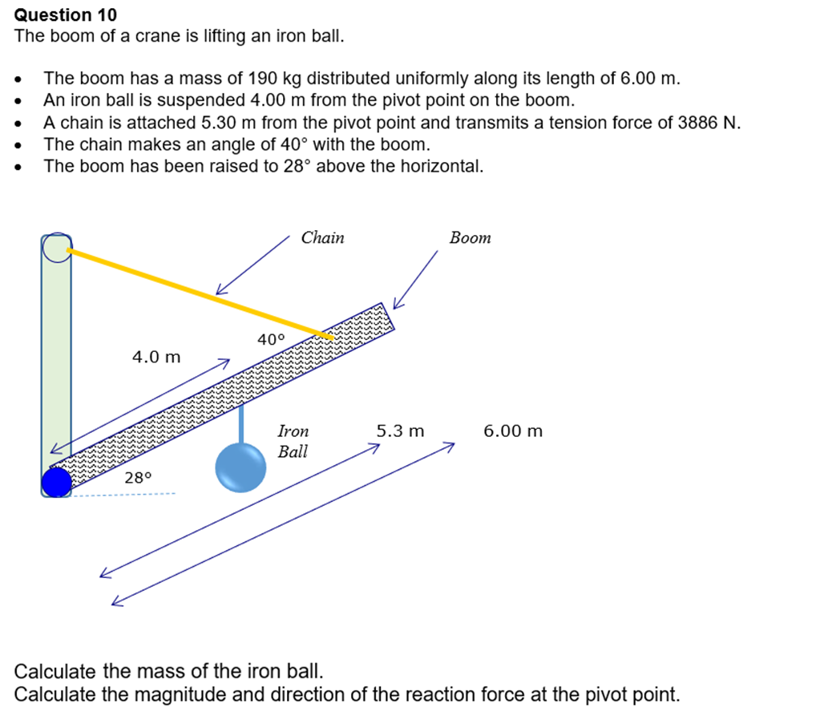
Static Equilibrium
You Do

Slide 25
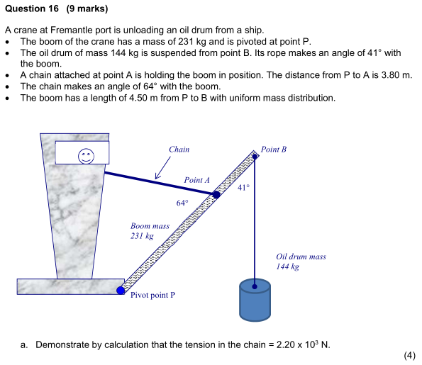
Static Equilibrium
You Do

Slide 26
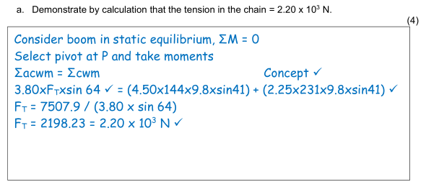
Static Equilibrium
Answers

Slide 27
Torque
Exam advice
Get your clockwise and anticlockwise correct.
You will nearly always be solving for rotational equilibrium (torque) first, then translational equilibrium. This is because any force at the pivot point will not have a torque (as r=0) and you can remove it from the torque equation
Be careful with the angles! Don’t be afraid to draw out your triangles. Use pencil.
Draw pictures. State the rules for equilibrium. Push on even if you are a bit confused – there are lots of part-marks in complex equilibrium questions!

Slide 28
Equilibrium
Success Criteria
I can state the rules for equilibrium.
I can calculate complex torque and equilibrium questions.

